Slide 1
WHALE OPTIMIZATION ALGORITHM FOR GLOBAL OPTIMIZATION
SCHWEFEL PROBLEM, ACKLEY FUNCTION AND GRIEWANK FUNCTION
GHEORGHE ANDREEA-IOANA
ELENA TAMARA IVANOF
GROUP 1021

Slide 2
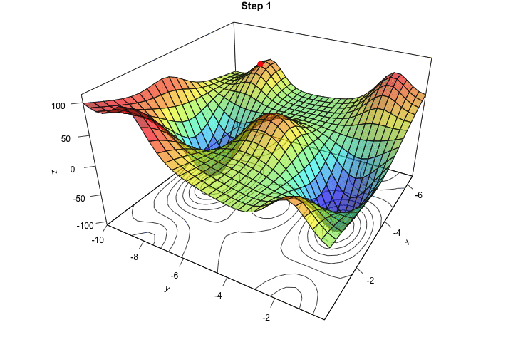
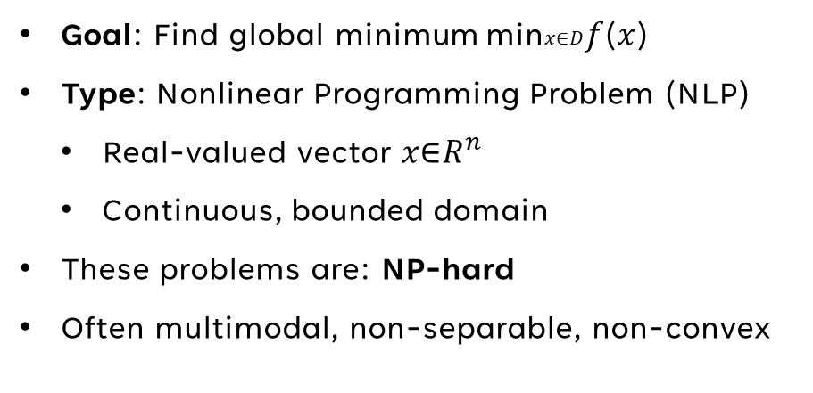
What Kind of Problem Are We Solving?
Goal: Find global minimum min⁡𝑥∈𝐷𝑓(𝑥)
Type: Nonlinear Programming Problem (NLP)
Real-valued vector 𝑥∈$R^{n}$
Continuous, bounded domain
These problems are: NP-hard
Often multimodal, non-separable, non-convex
Notes:
NP hard: Search space size grows exponentially with:
Number of variables
Precision

Slide 3
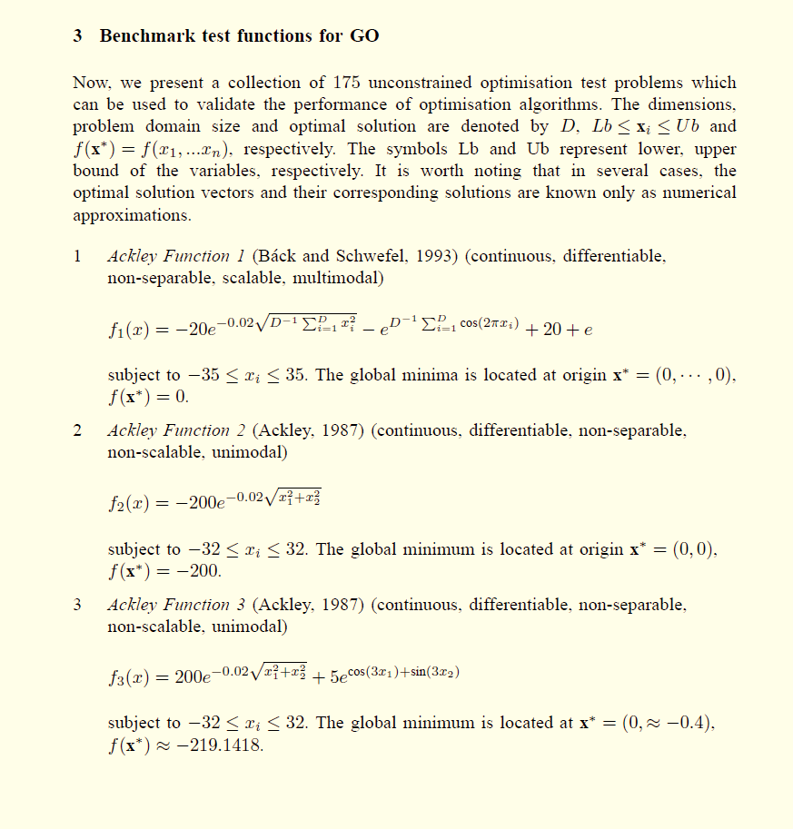
Benchmarking in literature
Common practice since 1990s: test algorithms on diverse functions
Benchmark sets must include:
Unimodal vs. Multimodal
Separable vs. Non-separable
Low- vs. High-dimensional
Helps identify where an algorithm is effective
Ackley, Griewank, Schwefel = standard tests for:
Robustness
Exploration/exploitation
Convergence

Slide 4
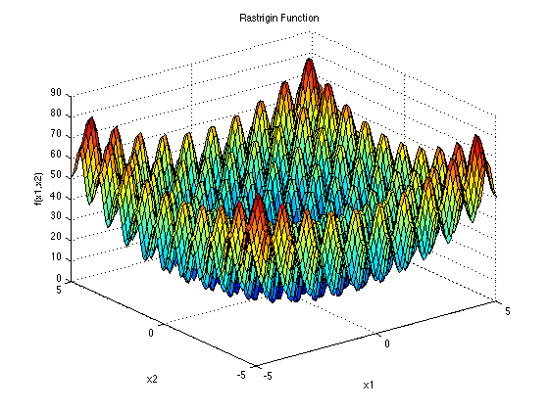
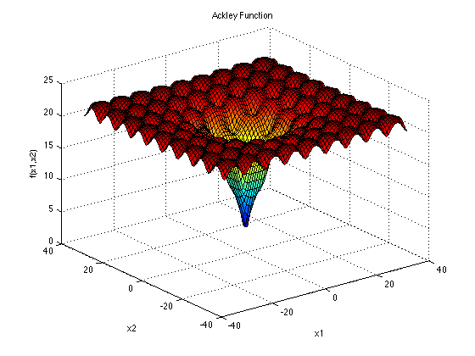
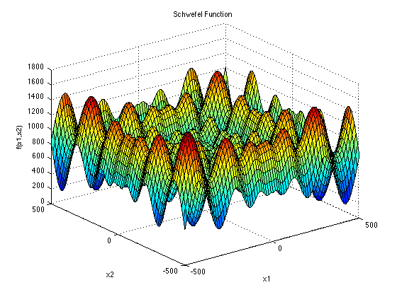
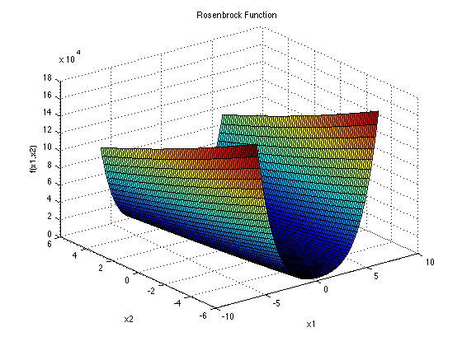
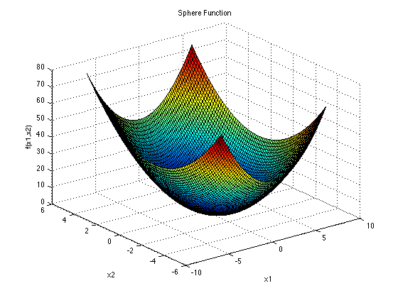
What Makes Benchmark Functions Challenging?
Modality
Unimodal: one optimum (easy)
Multimodal: many local minima
Basins
Flat or steep zones that trap algorithms
Dimensionality
High dimensional = exponential space growth
Valleys
Long, narrow zones with slow convergence
Separability
Easy: variables independent
Hard: interactions between variables

Slide 5
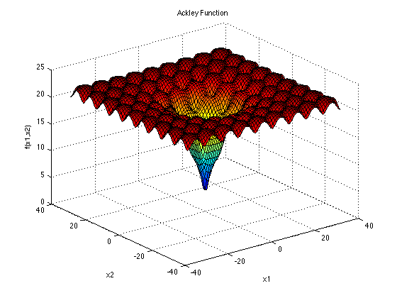
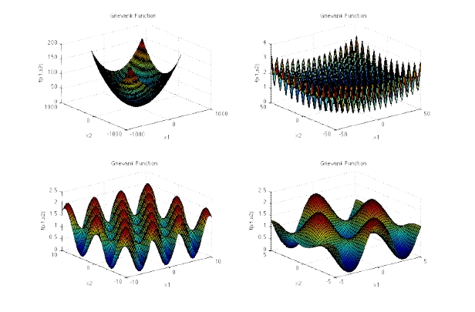
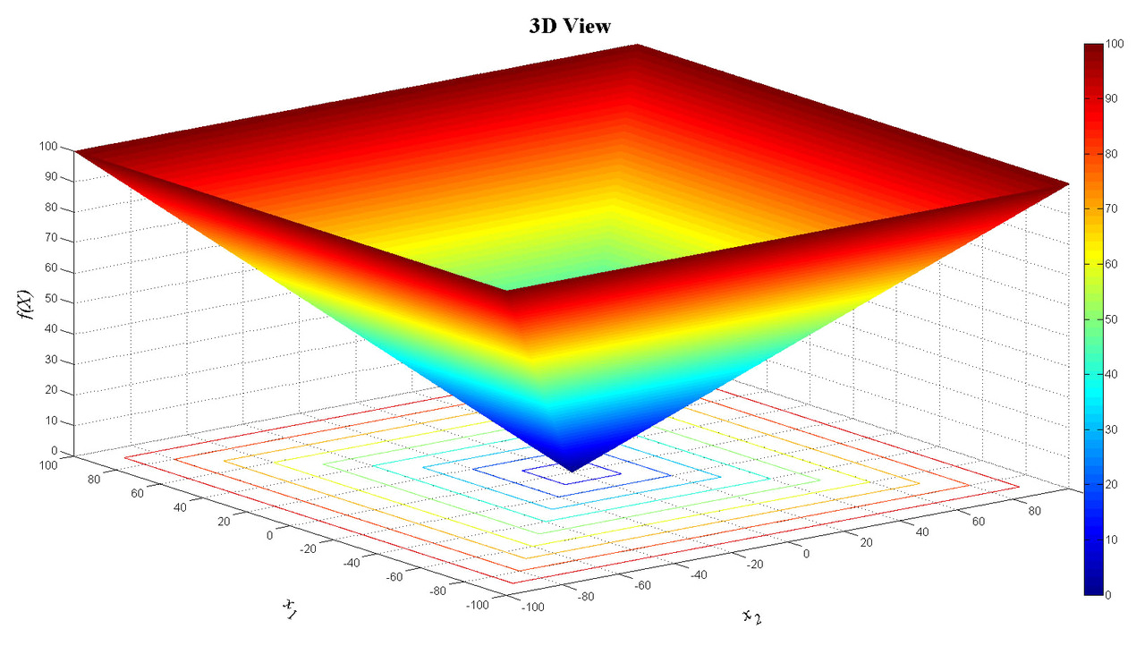
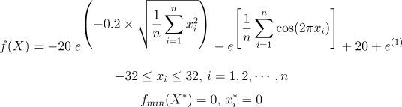
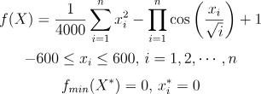
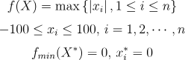
Schwefel's 2.21 Function
Ackley’s Function
Griewank's Function
5

Slide 6
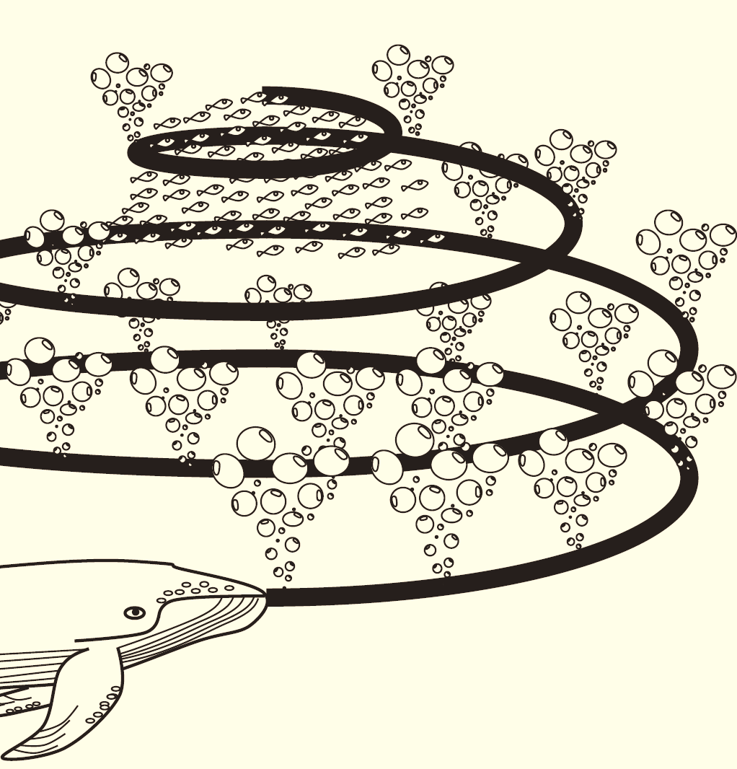
Inspiration Behind Whale Optimization Algorithm
The core inspiration is their bubble-net feeding technique, where whales create spiral-shaped bubbles to trap prey.
Researchers observed two key maneuvers:
Upward spirals: whales swim in a helix while releasing bubbles upward
Double loops: complex movement patterns around the prey
WOA simulates this behavior through three key mechanisms:
Encircling prey – models exploitation
Spiral updating position – mimics helix movement
Search for prey – models exploration

Slide 7
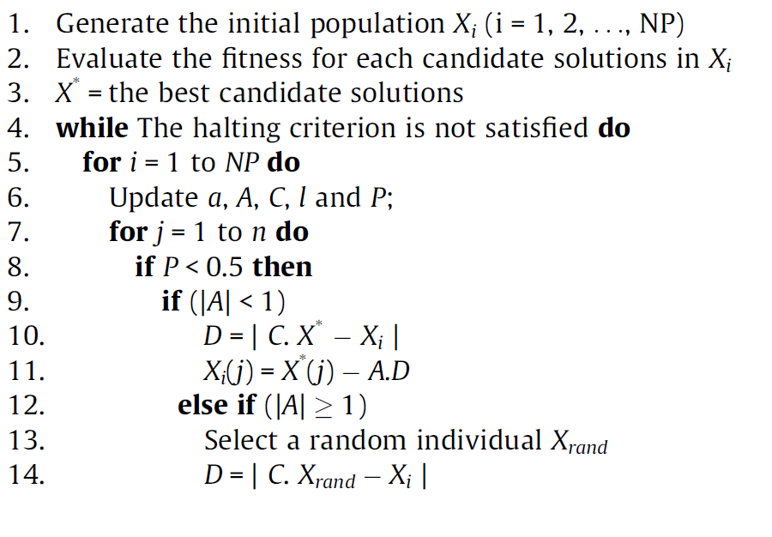
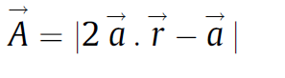
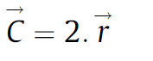
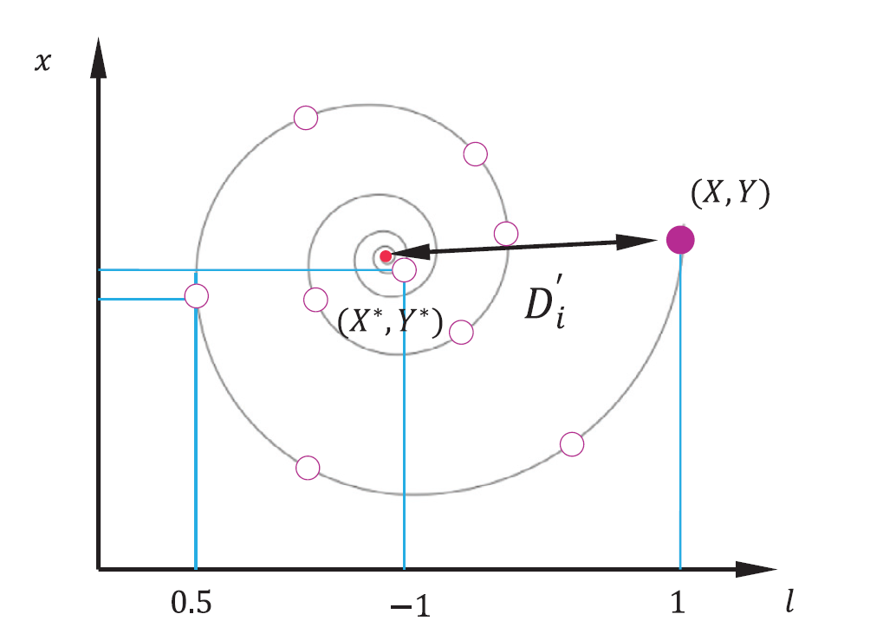
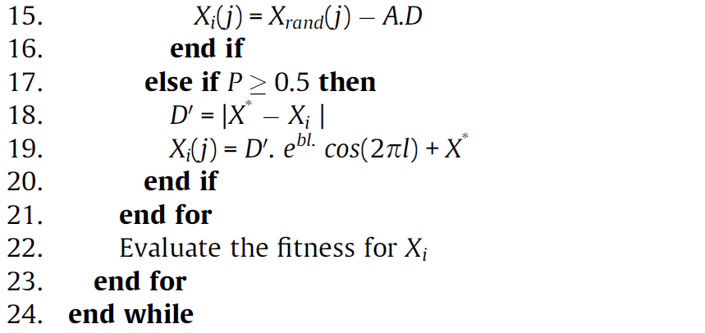

Slide 8
KEY DIFFERENCES BETWEEN WOA AND IWOA
Hybrid Search Operator merges:
* DE’s mutation
* WOA’s encircling, prey-searching, and spiral behaviors
* *Exploration part*: uses DE mutation + WOA's prey search
* *Exploitation part*: uses WOA’s shrinking circle and spiral update

Slide 9
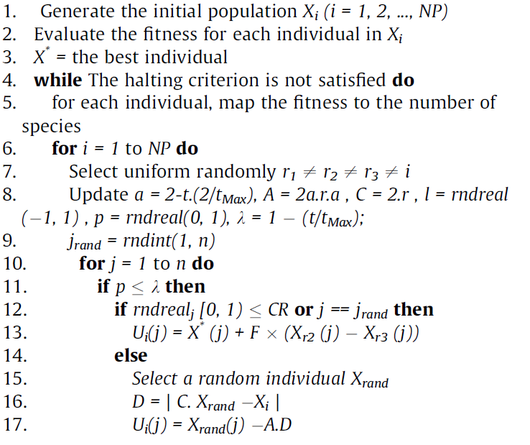
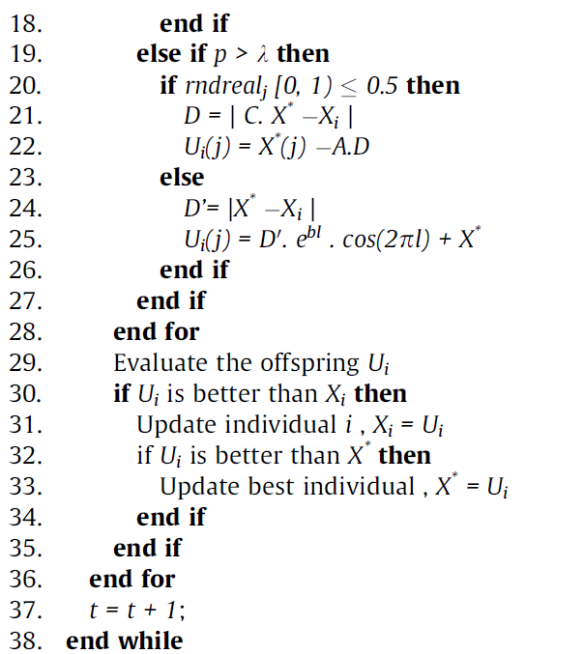
Notes:
* Still use instinct,
* But also share smart strategies from other sea creatures (DE),
* Learn over time when to explore and when to focus,
* And always keep the best fish they catch.

Slide 10
EXPERIMENTS

Slide 11
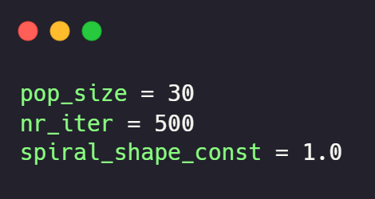
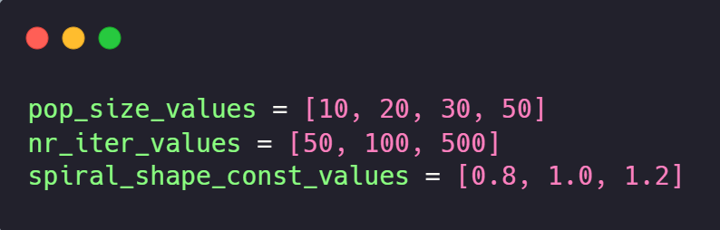
WOA Part 1: finding the ideal parameters
Parameter analysis based on:
- Population size: `pop_size`
- Number of iterations: `nr_iter`
- Shape of the logarithmic spiral: `spiral_shape_const`
Values we analyzed:
Works of Seyedali Mirjalili and Andrew Lewis
! Note: All experiments were performed on functions of dimension 2

Slide 12
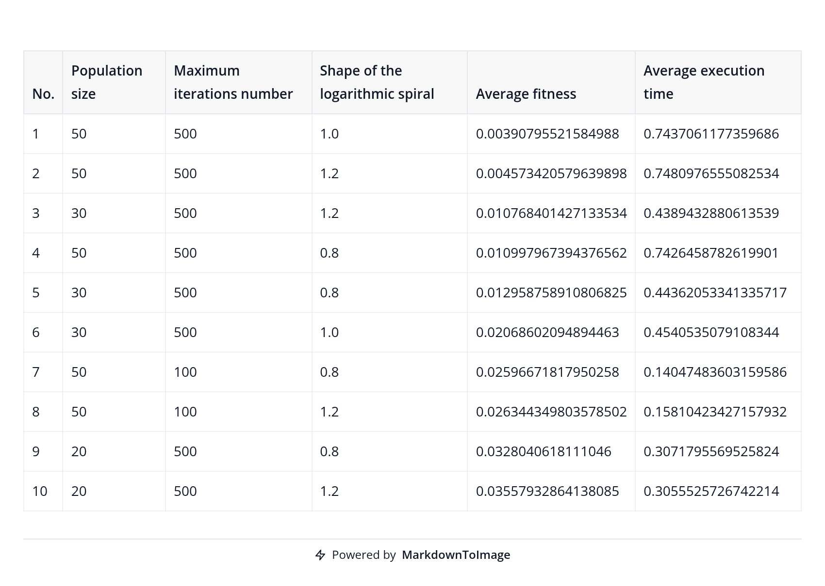

WOA Part 1: EXPERIMENT RESULTS
Best performing configuration found by us
Seyedali Mirjalili and Andrew Lewis

Slide 13
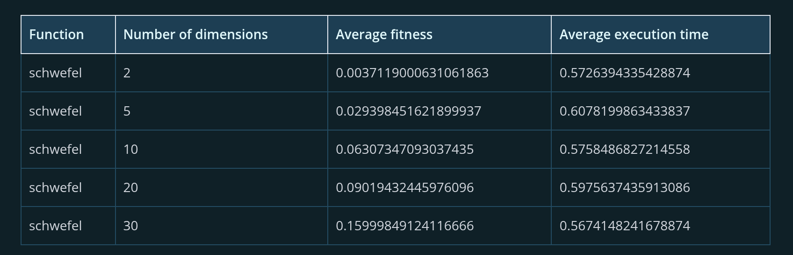
WOA Part 2: TEST ALGORITHM ON HIGHER DIMENSIONS
Schwefel's 2.21 Function

Slide 14
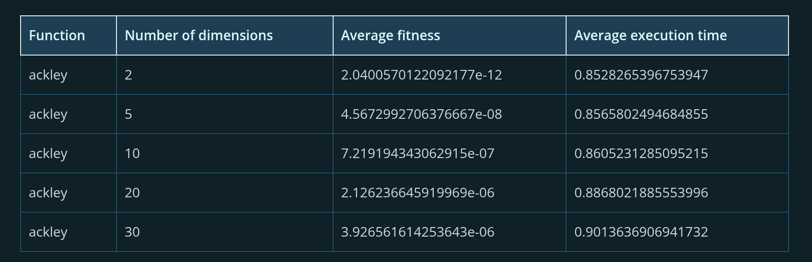
WOA Part 2: TEST ALGORITHM ON HIGHER DIMENSIONS
Ackley’s Function

Slide 15
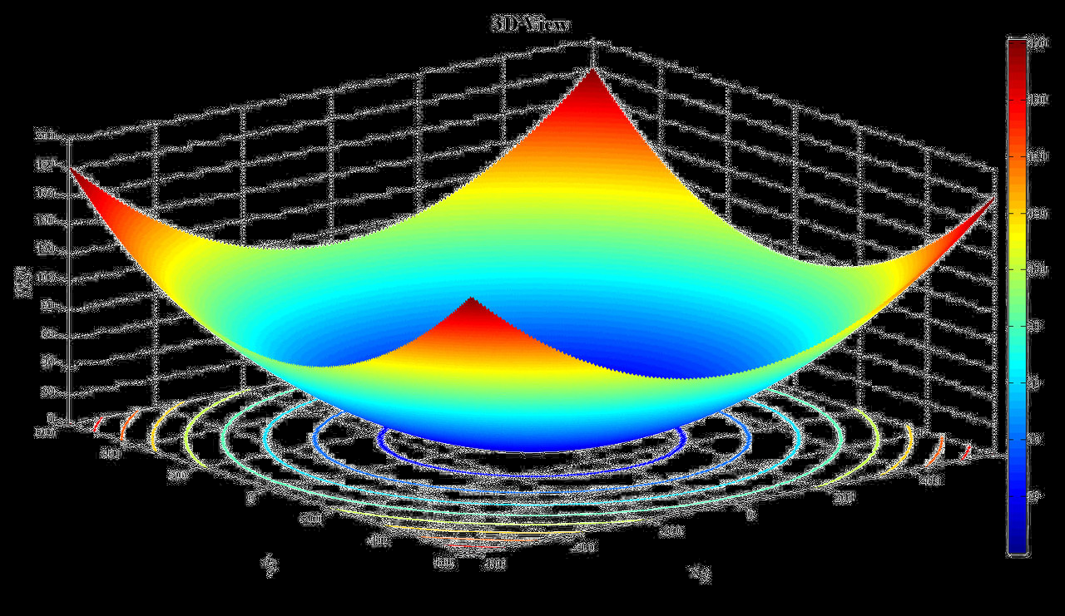
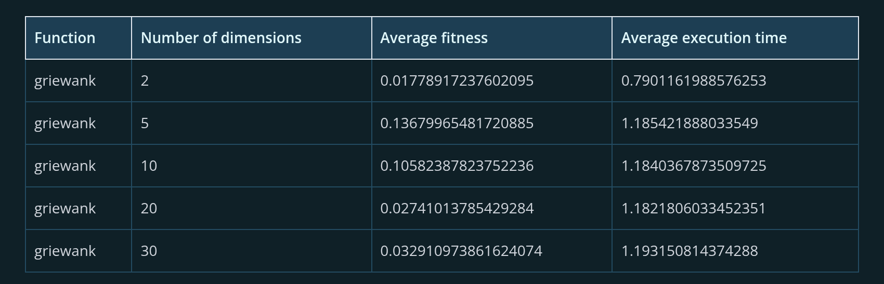
WOA Part 2: TEST ALGORITHM ON HIGHER DIMENSIONS
Griewank's Function

Slide 16
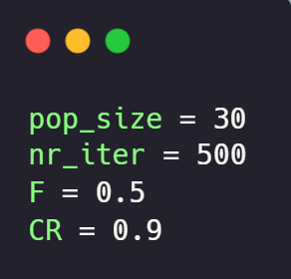
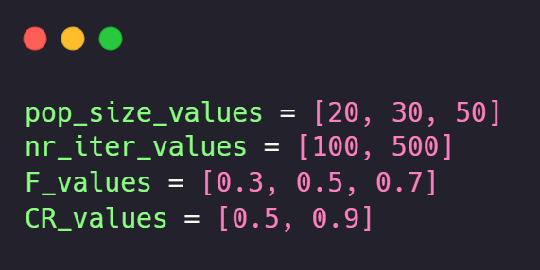
IWOA Part 1: finding the ideal parameters
Parameter analysis based on:
- Population size: `pop_size`
- Number of iterations: `nr_iter`
- Differential weight: `F`
- Crossover probability: `CR`
Values we analyzed:
Works of Seyed Mostafa Bozorgi and Samaneh Yazdani
! Note: All experiments were performed on functions of dimension 2

Slide 17
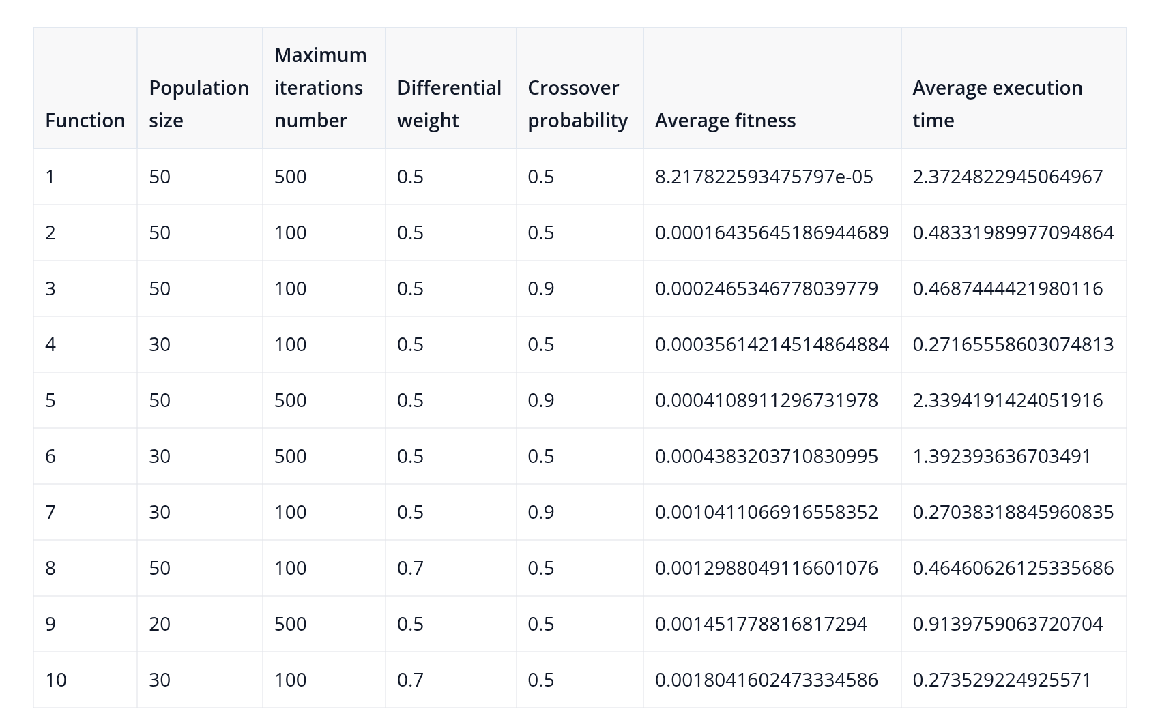
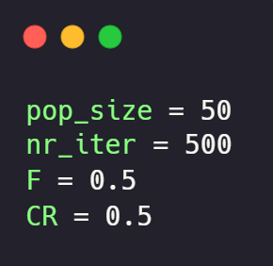
IWOA Part 1: EXPERIMENT RESULTS
Best performing configuration found by us
Seyed Mostafa Bozorgi and Samaneh Yazdani

Slide 18
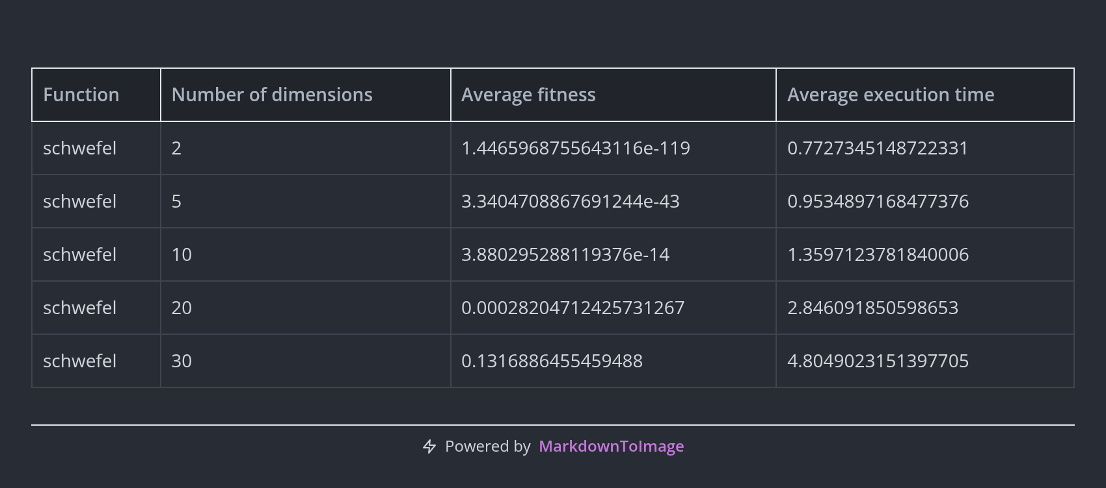
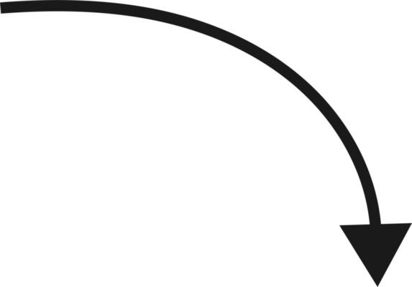
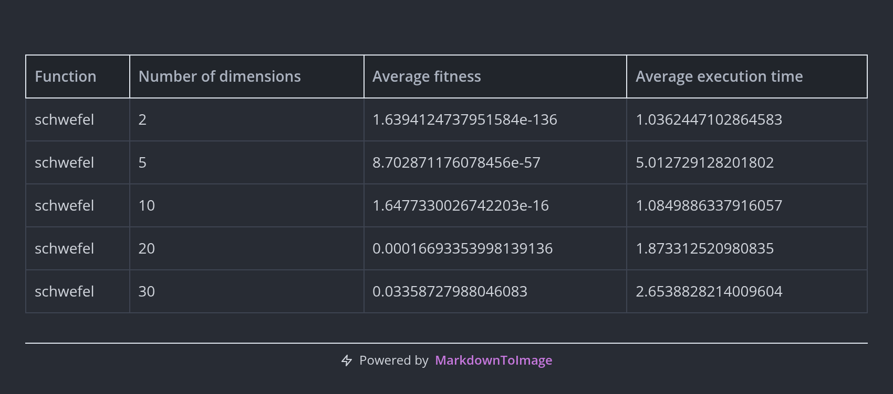

IWOA Part 2: TEST ALGORITHM ON HIGHER DIMENSIONS
Schwefel's 2.21 Function

Slide 19
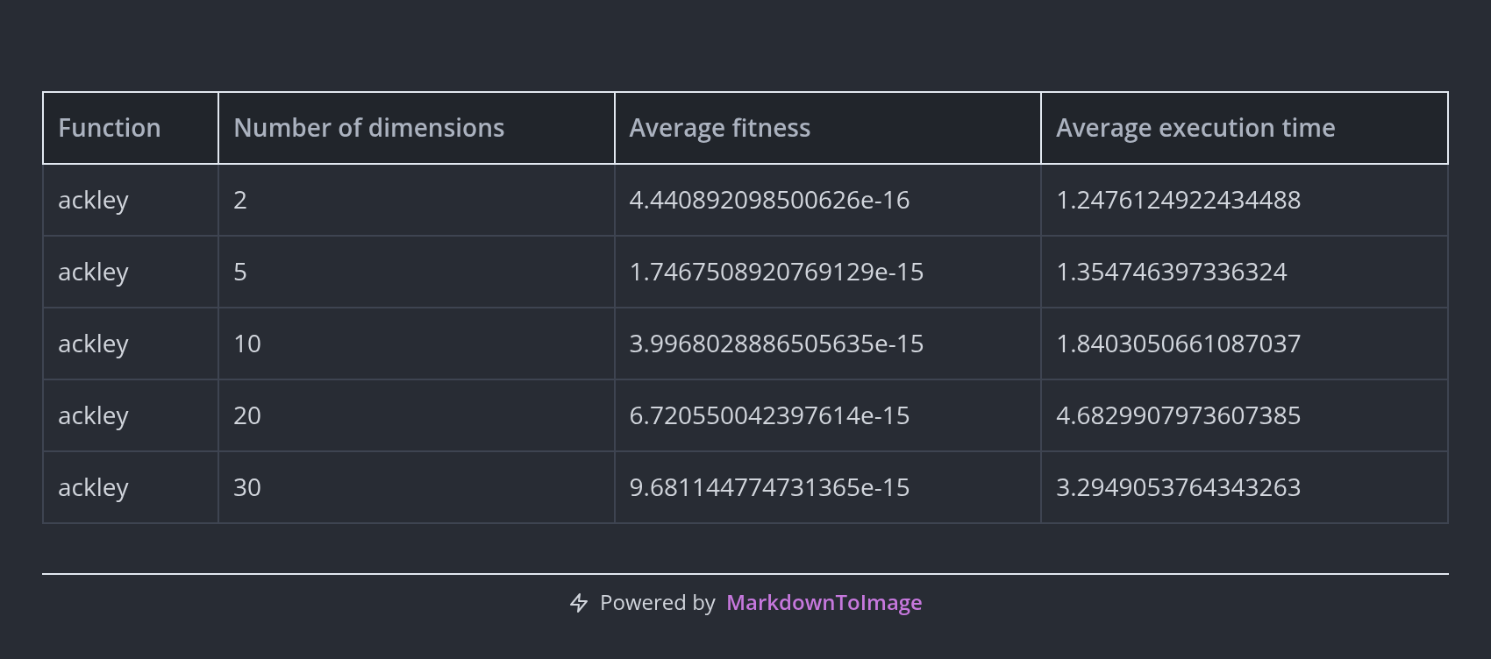
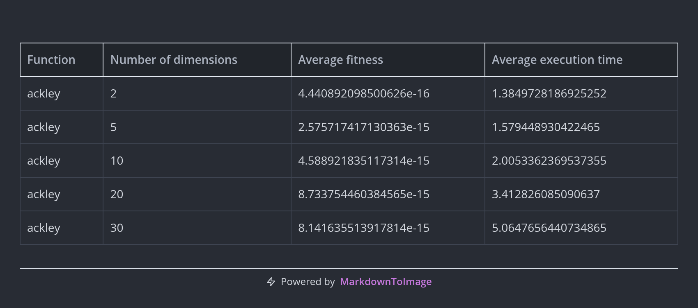
IWOA Part 2: TEST ALGORITHM ON HIGHER DIMENSIONS
Ackley’s Function

Slide 20
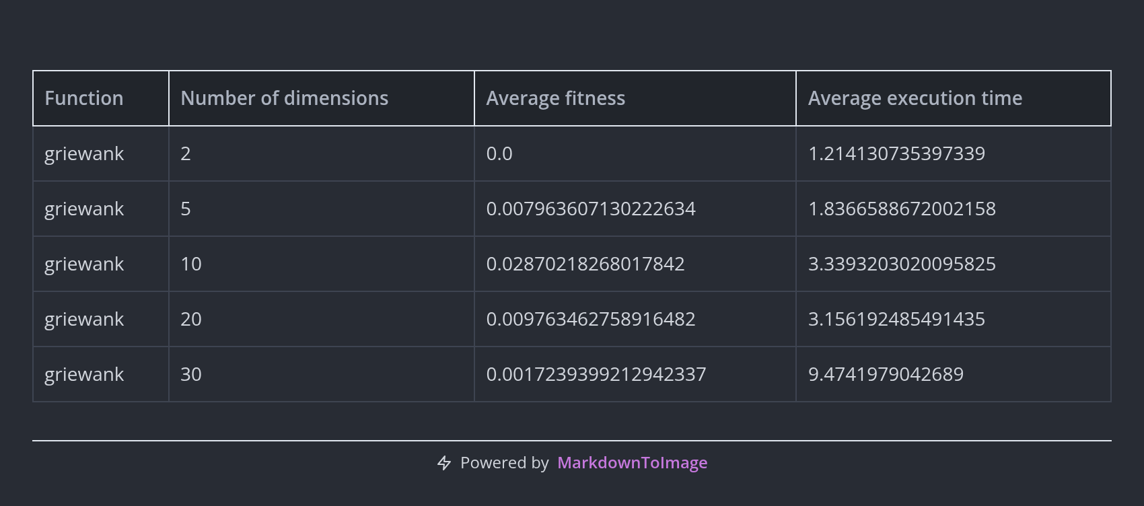
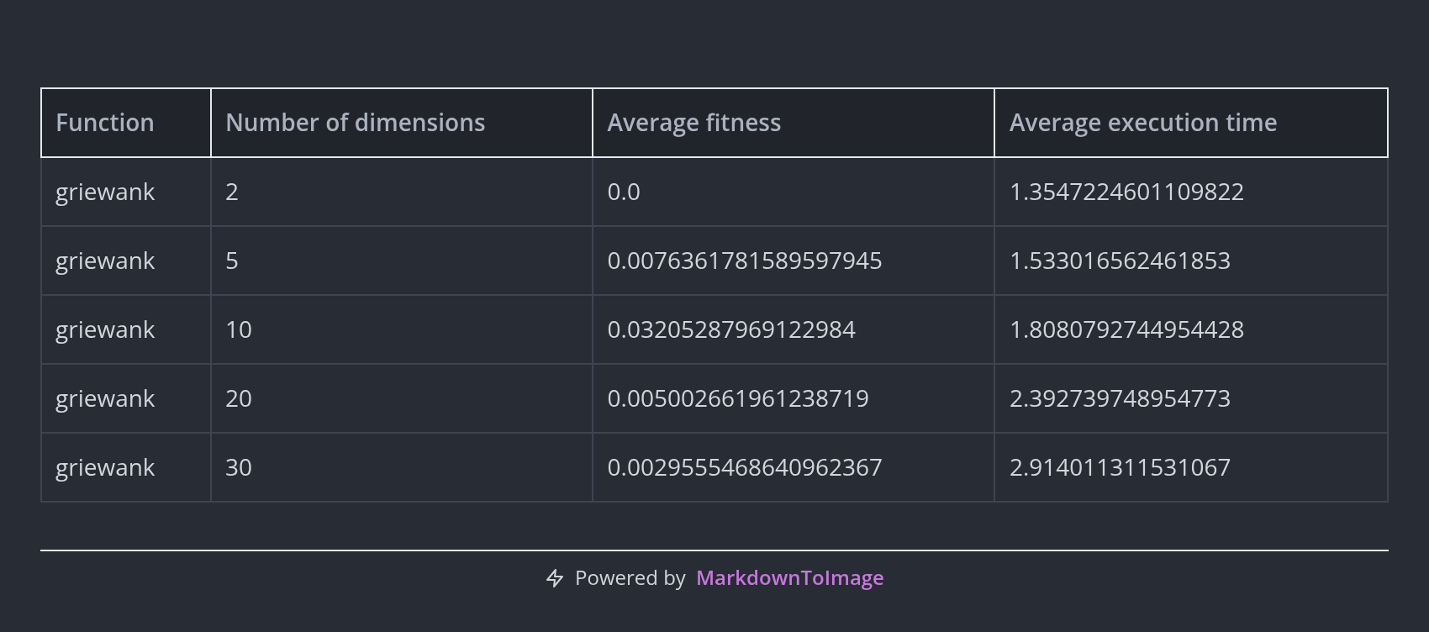
IWOA Part 2: TEST ALGORITHM ON HIGHER DIMENSIONS
Griewank's Function

Slide 21
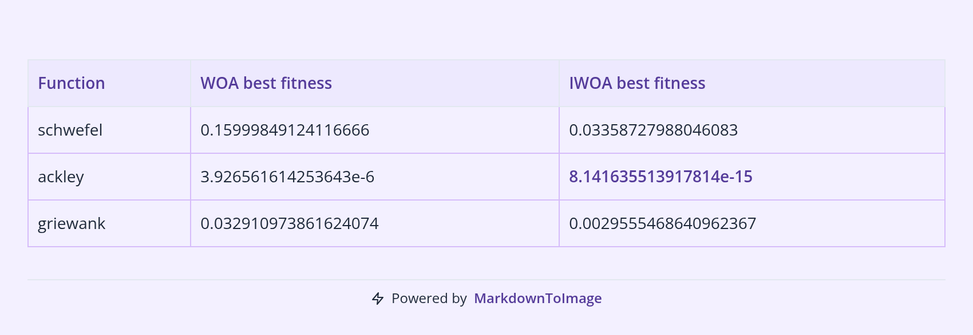
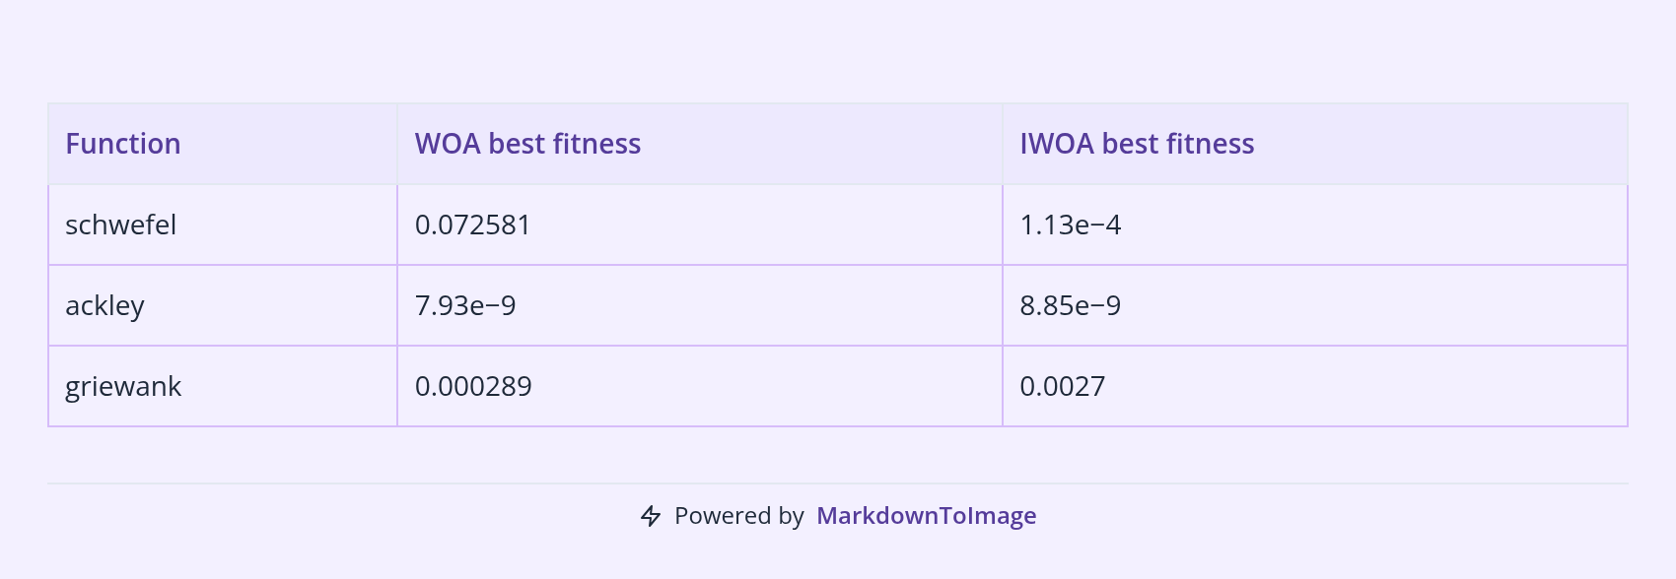
COMPARATIVE EXPERIMENT RESULTS
Best results obtained by us
Results obtained by paper authors

Slide 22
conclusions
IWOA improves the performance of WOA, especially in multimodal test functions.
IWOA converges slower than WOA, but it obtains better performance or results on multimodal functions.
Potential improvements:
Chaos‐based parameter control
Fuzzy logic‐based switching

Slide 23
THANK YOU!
Do you have any questions?

